Slide 1





Getting Started With
Microsoft Access
Database
1
Manager of Information Center
Tendering Department
Arab Contractors
Said Fawzy

Slide 2


Course Introduction

Slide 3
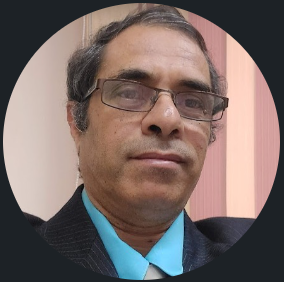

Contact
Cert.
Cert.
Certif.
Quali
JOB
Said Fawzy
Manager of Information Center
Quality Manager
Tendering Department
Arab Contractors

Slide 4
Contact
Cert.
Cert.
Cert.
Quali.
JOB
Said Fawzy
Manager of Information Center
Quality Manager
Tendering Department
Arab Contractors

Slide 5


B.SC In Civil Engineering
1987
Alex University
Contact
Cert.
Cert.
Cert.
Quali.
JOB
Said Fawzy
Manager of Information Center
Tendering Department
Arab Contractors
High Diploma in Construction Project Management
1998
Ein Shams
University

Slide 6



Microsoft Certified Professional (MCP)
1999
B.SC In Civil Engineering
1987
Certified Internet Webmaster(CIW)
2000
Alex University
Contact
Cert.
Cert.
Cert.
Quali.
JOB
Said Fawzy
Manager of Information Center
Tendering Department
Arab Contractors
High Diploma in Construction Project Management
2001
Oracle Certified Master (OCM)
1998
Ein Shams
University
Microsoft Certified Technology Specialist(MCTS)
2006

Slide 7



Microsoft Certified Professional (MCP)
1999
Lead Auditor Quality Management Systems
B.SC In Civil Engineering
2009
1987
Certified Internet Webmaster(CIW)
2000
Alex University
Contact
Cert.
Cert.
Cert.
Quali.
JOB
Said Fawzy
Manager of Information Center
Tendering Department
Arab Contractors
High Diploma in Construction Project Management
2001
Oracle Certified Master (OCM)
1998
Lead Auditor Quality Management Systems
Ein Shams
University
2016
Microsoft Certified Technology Specialist(MCTS)
2006

Slide 8

Advanced Data Analysis Nanodegree
2021
Microsoft Certified Professional (MCP)
1999
Lead Auditor Quality Management Systems
B.SC In Civil Engineering
2009
1987
2022
2000
Nanodegree UX Research Cross-Skilling
Certified Internet Webmaster(CIW)
Alex University
Contact
Cert.
Cert.
Cert.
Quali.
JOB
Said Fawzy
Manager of Information Center
Tendering Department
Arab Contractors
High Diploma in Construction Project Management
2022
2001
Nanodegree Advanced Marketing Analytics
1998
Oracle Certified Master (OCM)
Lead Auditor Quality Management Systems
Ein Shams
University
2016
2023
2006
Microsoft Certified Technology Specialist(MCTS)
IBM Certified Data Analysist Professional

Slide 9


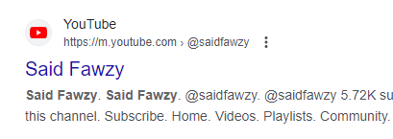
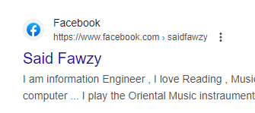
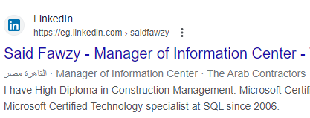


Advanced Data Analysis Nanodegree
2021
Microsoft Certified Professional (MCP)
1999
Lead Auditor Quality Management Systems
B.SC In Civil Engineering
2009
1987
2022
2000
Nanodegree UX Research Cross-Skilling
Certified Internet Webmaster(CIW)
Alex University
Contact
Cert.
Cert.
Cert.
Quali.
JOB
Said Fawzy
Manager of Information Center
Tendering Department
Arab Contractors
High Diploma in Construction Project Management
2022
2001
Nanodegree Advanced Marketing Analytics
1998
Oracle Certified Master (OCM)
Lead Auditor Quality Management Systems
Ein Shams
University
2016
0122 744 99 87
2023
2006
Microsoft Certified Technology Specialist(MCTS)
IBM Certified Data Analysist Professional
Saidfawzy@arabcont.com
Said_fawzy@hotmail.com

Slide 10



Prerequisite
Basic Computer Skills
Turn on and operate a computer or laptop.
Use a mouse and keyboard comfortably.
Open and close programs and files.
Navigate folders and drives to find and save documents.
Basic Understand of Spreadsheets.

Slide 11


Slide 12

Chapter 1
What is a Database
Chapter 2
Exploring MS Access Database
Chapter 3
Entity Relationship Diagram (ERD)
Chapter 4
Logical Model
1

Slide 13
Chapter 5
Building Tables
Chapter 6
Tables Relationship
Chapter 7
Query Basics
2

Slide 14
Chapter 8
Form Basics
Chapter 9
Report Basics
Chapter 10
Advanced Query Topics
Chapter 11
Automating Queries with Parameters
3

Slide 15
Chapter 12
Action Queries
Chapter 13
Advanced Form Design Techniques
Chapter 14
Navigation and Switchboard Forms
Chapter 15
Advanced Report Design Techniques
4

Slide 16
Chapter 16
Final Project
5

Slide 17


Training
Tell me I will forget.
Show me I might remember something.
Let me do it I will understand.

Slide 18




How would we train?
Lab

Slide 19

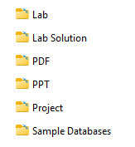
Student Folder

Slide 20
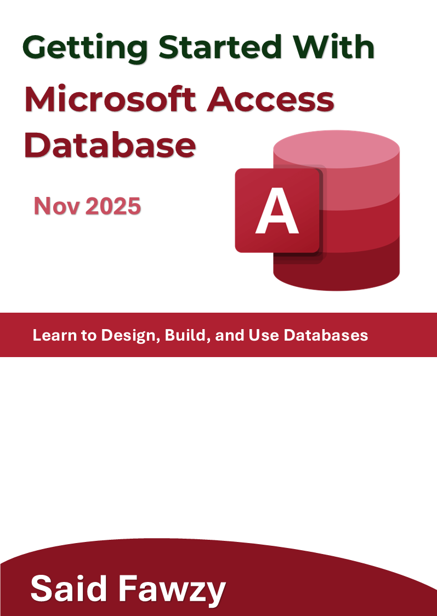
TRAINING ARE BASED ON BOOKS
TRAINING ARE BASED ON BOOKS
https://github.com/saidfawzy

Slide 21


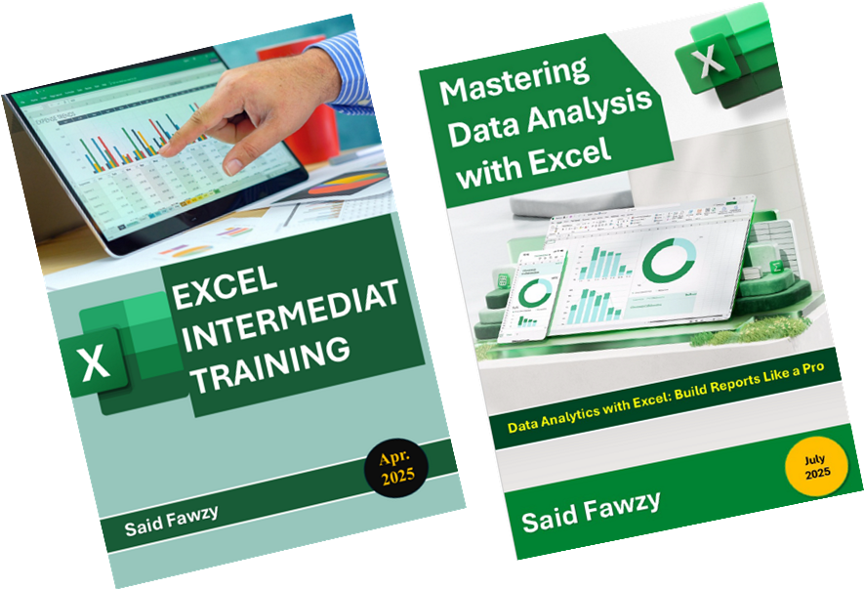

TRAINING ARE BASED ON BOOKS
TRAINING ARE BASED ON BOOKS
https://github.com/saidfawzy

Slide 22


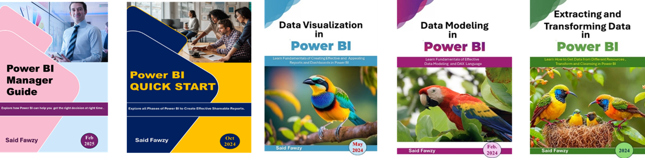
TRAINING ARE BASED ON BOOKS
TRAINING ARE BASED ON BOOKS
https://github.com/saidfawzy

Slide 23




JOINE TRAINING GROUPS
Telegram Group
WhatsApp Group
LinkedIn Group
Facebook Group

Slide 24



You are Allowed to Talk
about anything except
Religion
Policy
Soccer

Slide 25


Slide 26

Said Fawzy

